Slide 1
Education Development Trust

Slide 2

Who we are.
ABOUT EDT
We are an international not-for-profit organisation that works with governments around the world, combining our expertise with global research and regional knowledge to deliver programmes and inform education policy and practice and around the world.

Slide 3

Our vision.
ABOUT EDT
A world in which all lives are transformed through excellent education.
Our values.
Everything we do is underpinned by our values of excellence, integrity, accountability, collaboration and inclusion.

Slide 4
What we do.
ABOUT EDT
GLOBAL SUPPORT
TEACHER DEVELOPMENT
We develop evidence-informed solutions to bring about real change, improve school systems at scale, and support global efforts to address learning crises and reduce inequalities of opportunity.
We do so using our specialist expertise in system change, accountability, teacher development, leadership development, school-to-school collaboration, and education programme design and implementation.
RESEARCH
PRACTICE
Our work is grounded in evidence of what works in education reform, drawing on our continually refreshed body of research, in which we invest annually.
In addition, we also deploy our expertise in programme implementation to provide employability and careers services, and we own and manage a family of independent schools, in which we put our knowledge of excellent teaching and learning into practice.

Slide 5
About the comic book project

Slide 6
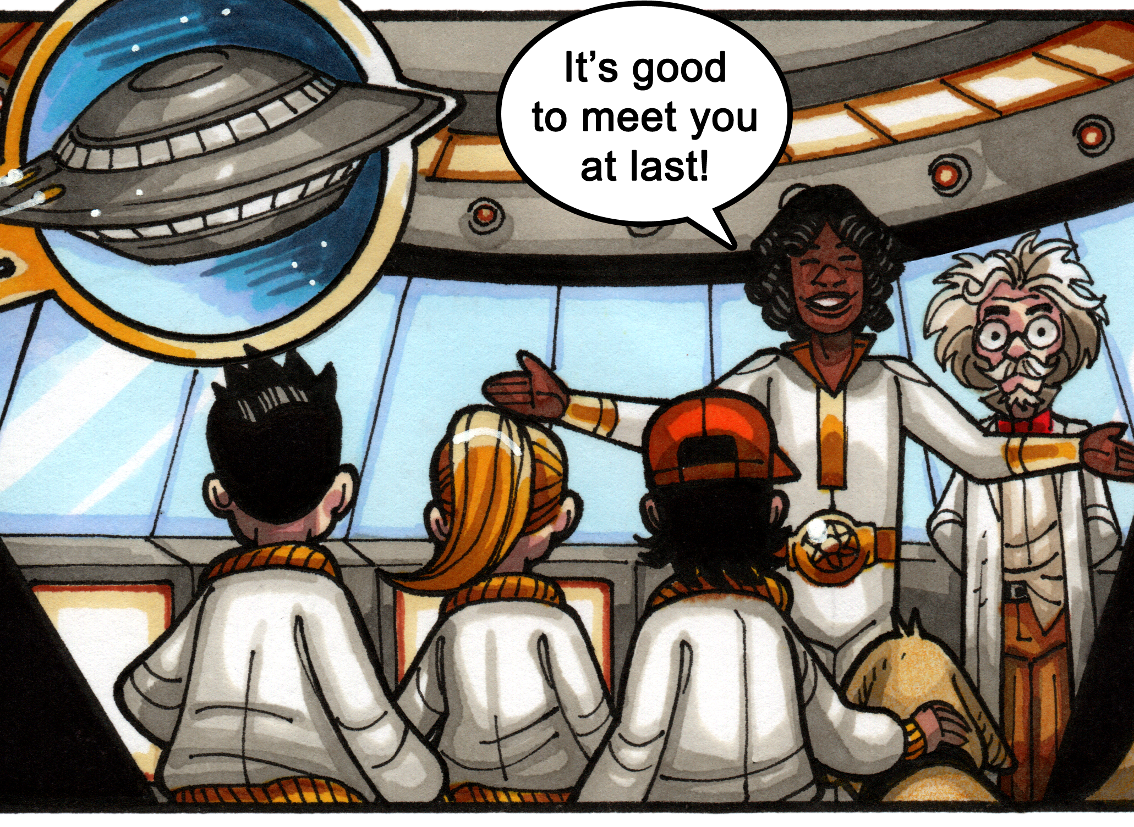
An eight-week reading programme.
A climate change, super hero comic project aimed at engaging, exciting, and educating Key Stage 2 (Year 3) students who are not yet making expected reading progress.

Slide 7

Initial trial feedback.
“The data is very positive.
More importantly, we would like to highlight the impact this intervention has had on confidence and attitudes within these two groups of children. This has been extremely significant.”

Slide 8
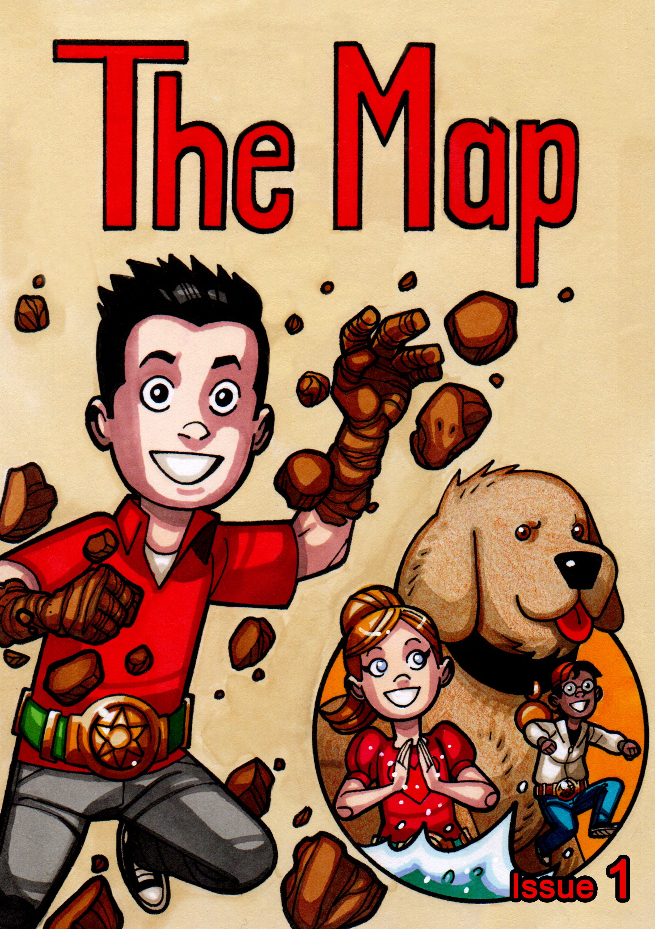
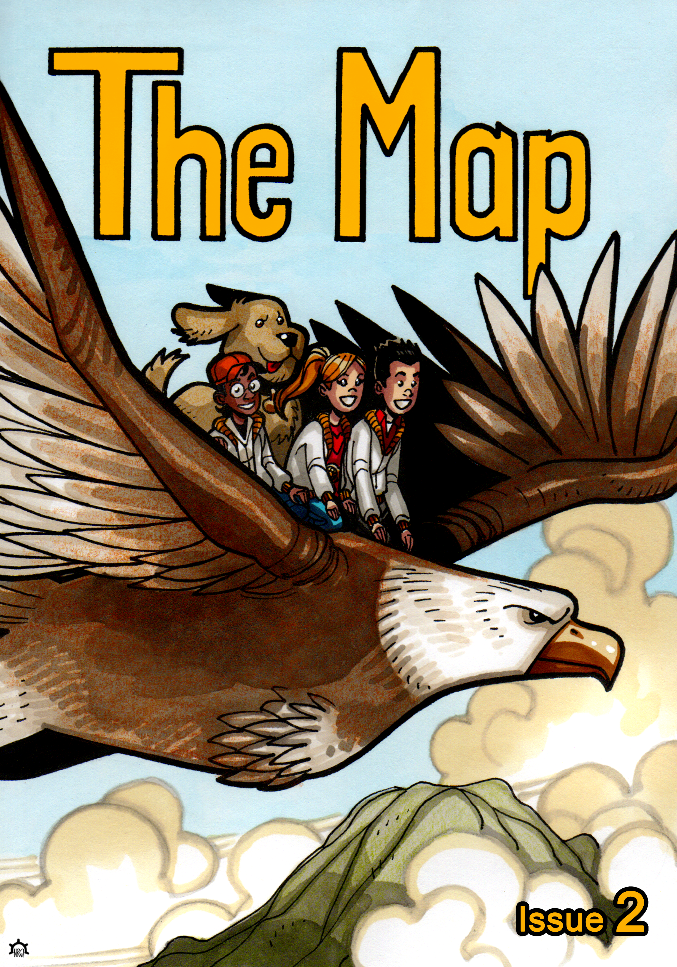
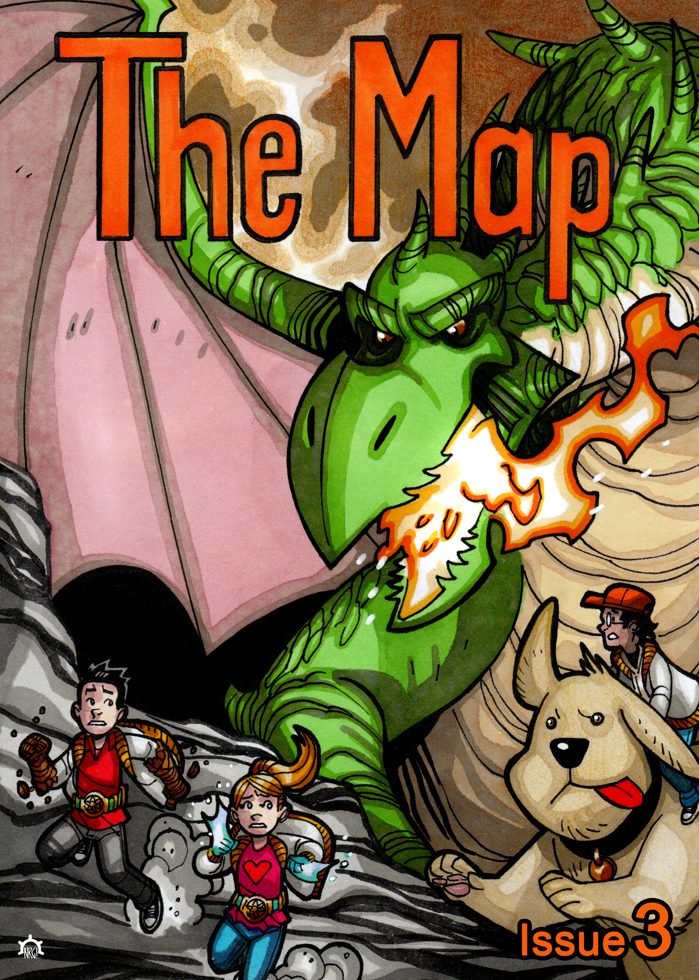
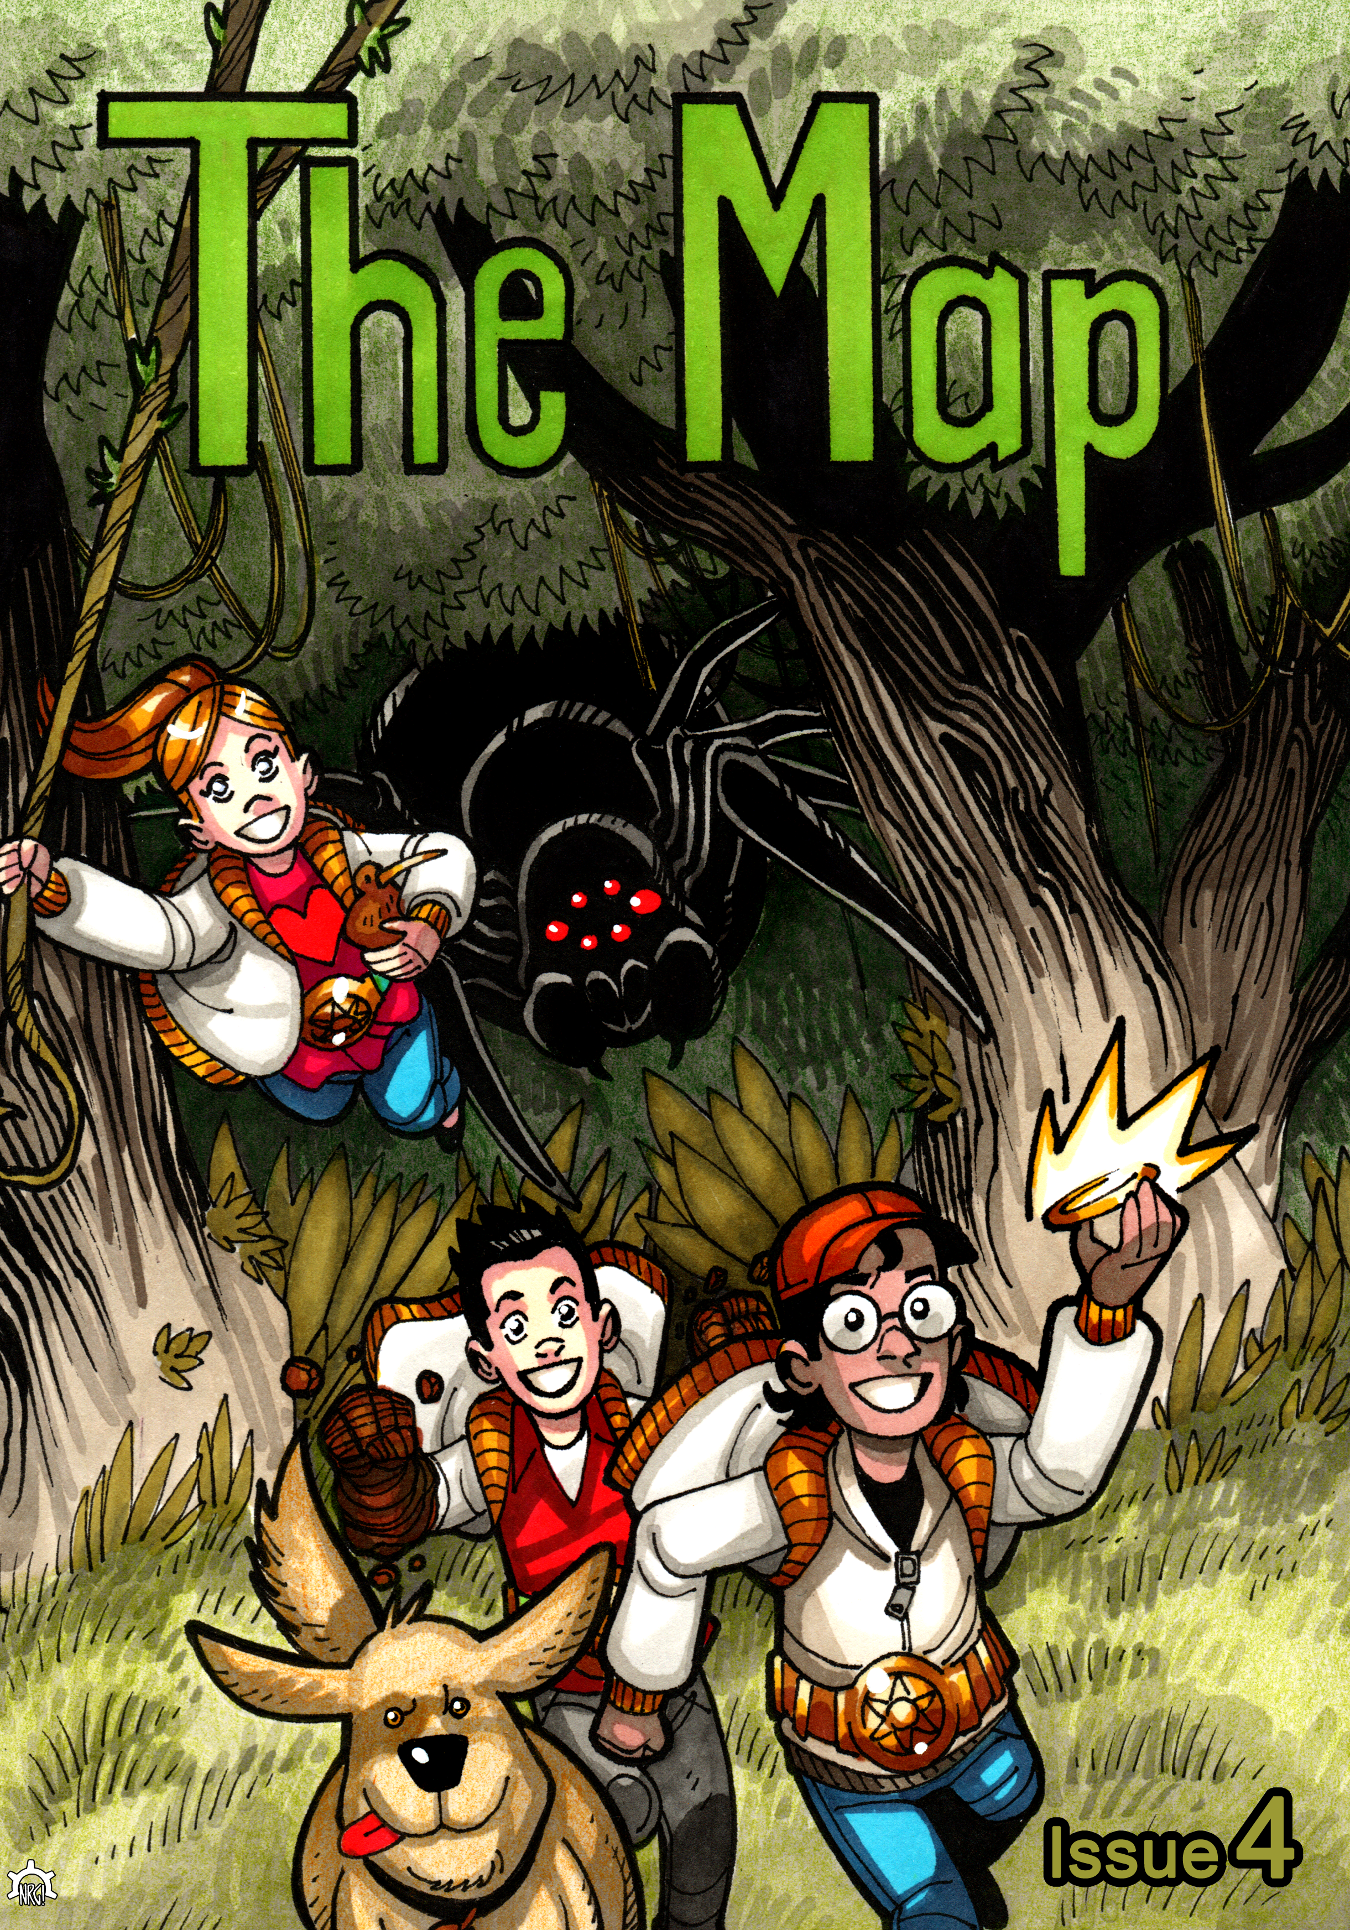
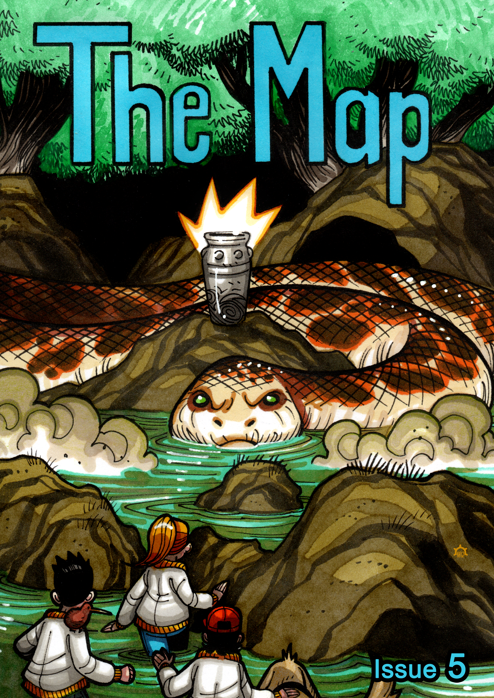
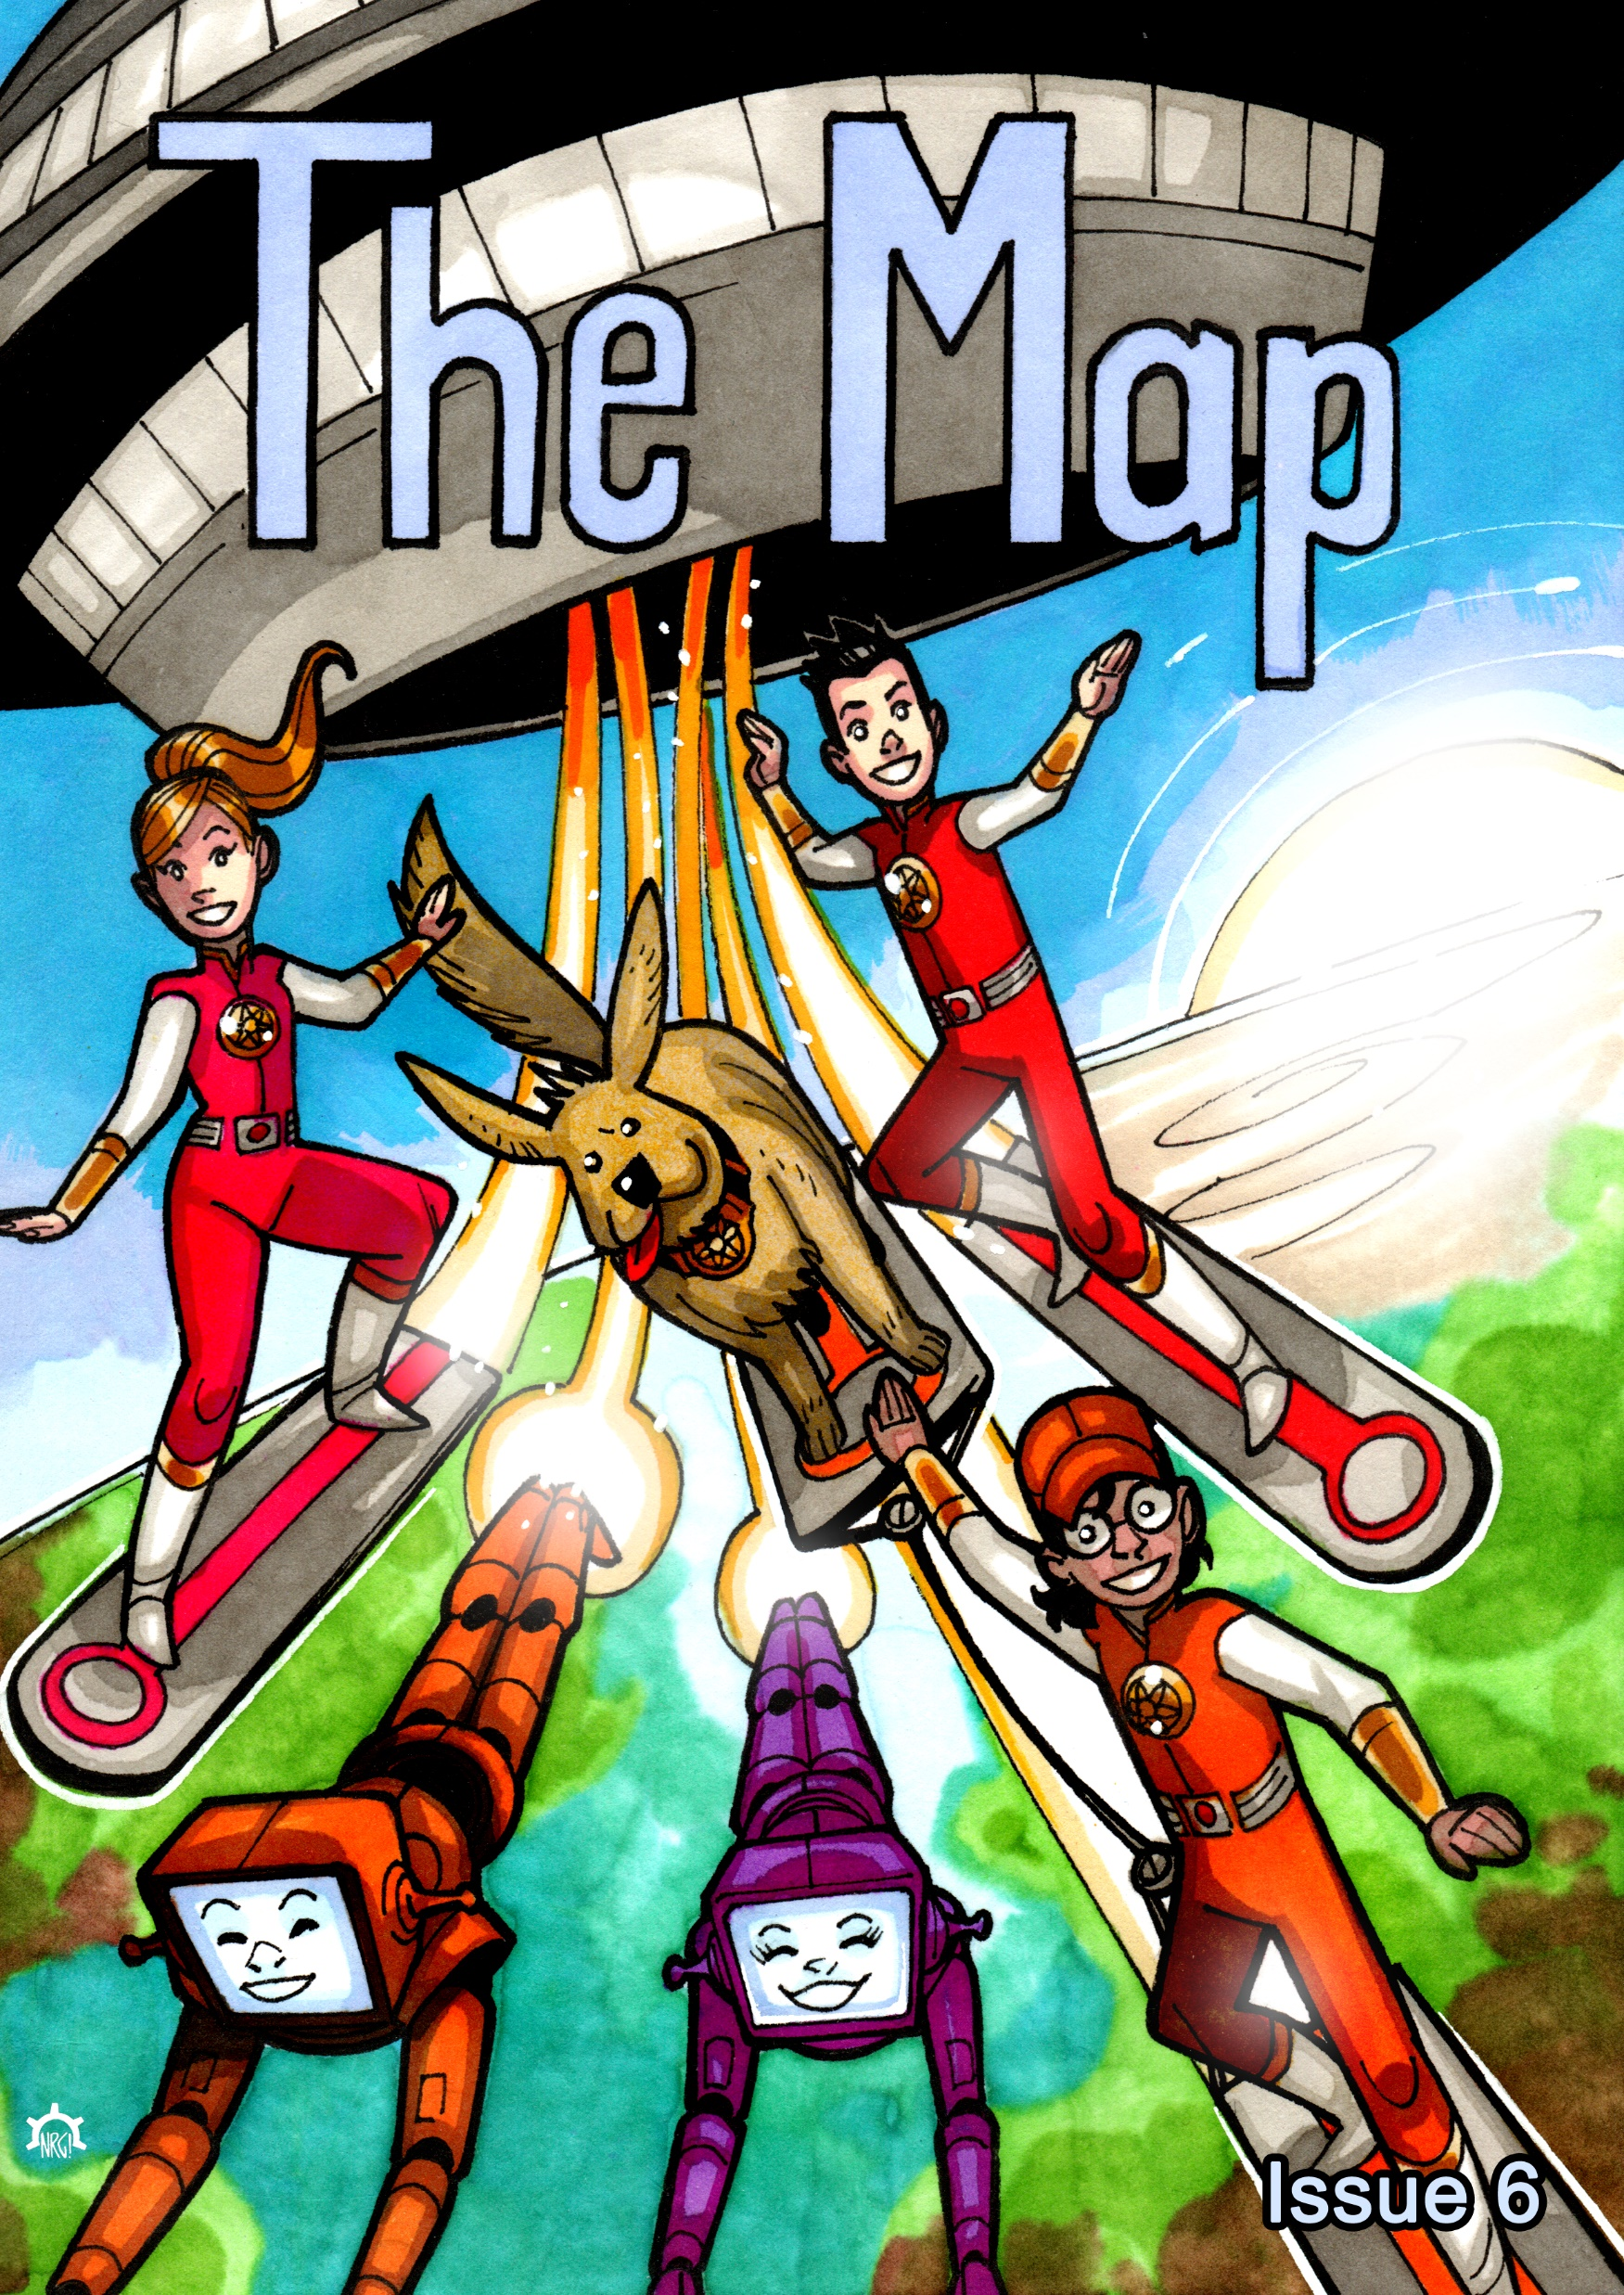
Materials.
Comics
Engagement activities
Read aloud stories
Lesson planning
Assessments

Slide 9
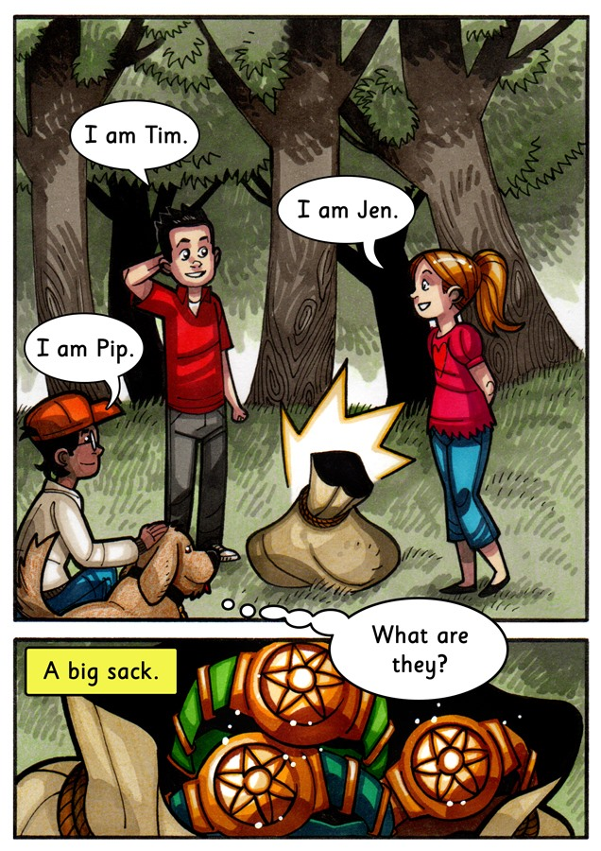
Comics.
Fully decodable.
Incremental development.
Continuous story series.
Engaging and age appropriate.

Slide 10

Read aloud stories .
Focusing on academic vocabulary as a pathway through KS2 and into the KS3 curriculum.
Supporting working memory and comprehension.
Brief in duration and suitable for sharing with the entire class.

Slide 11
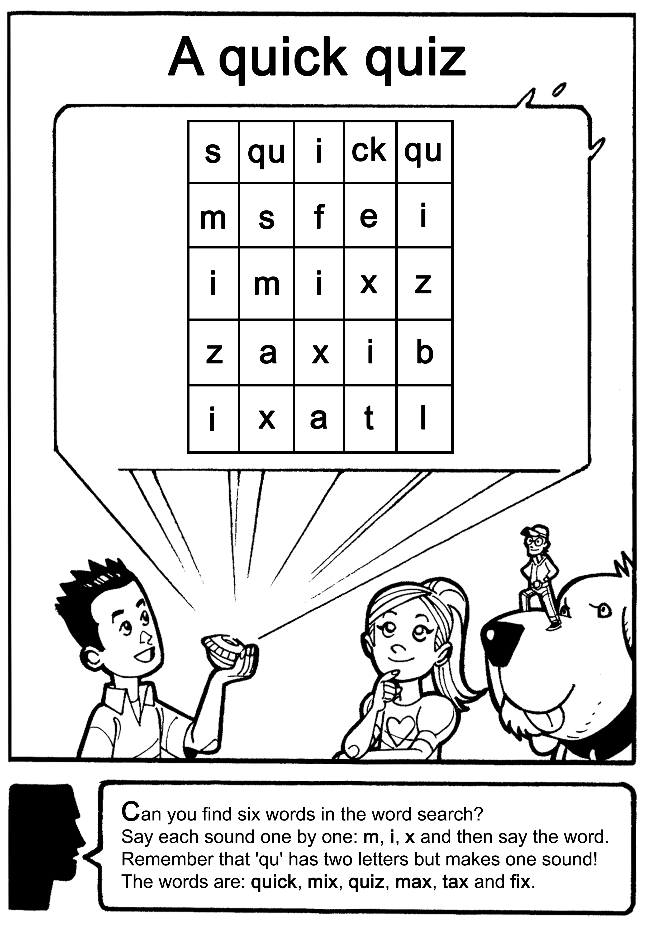
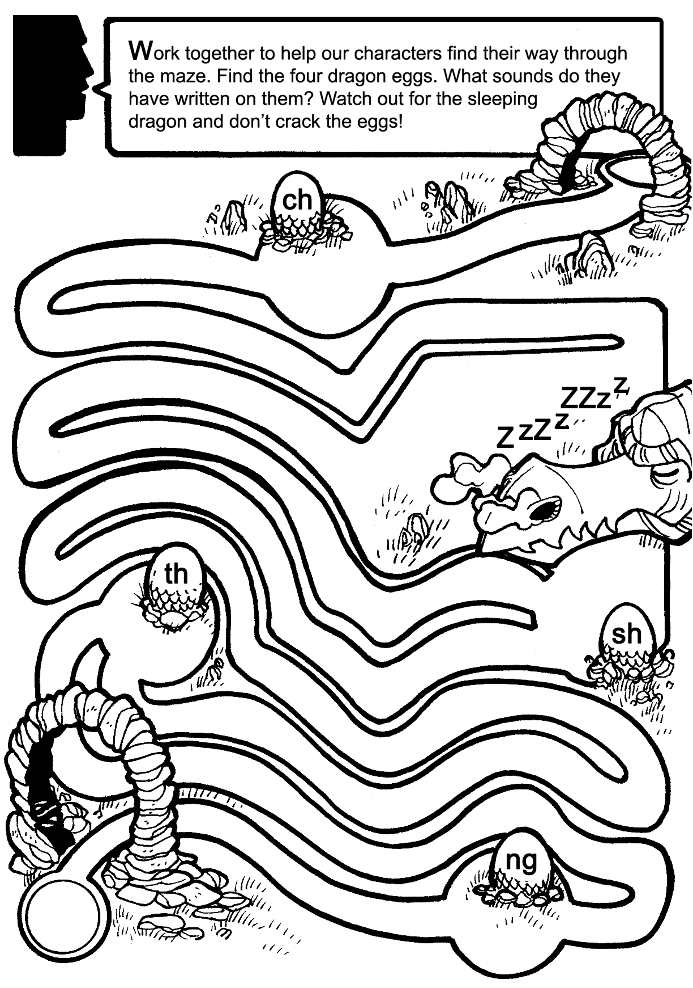
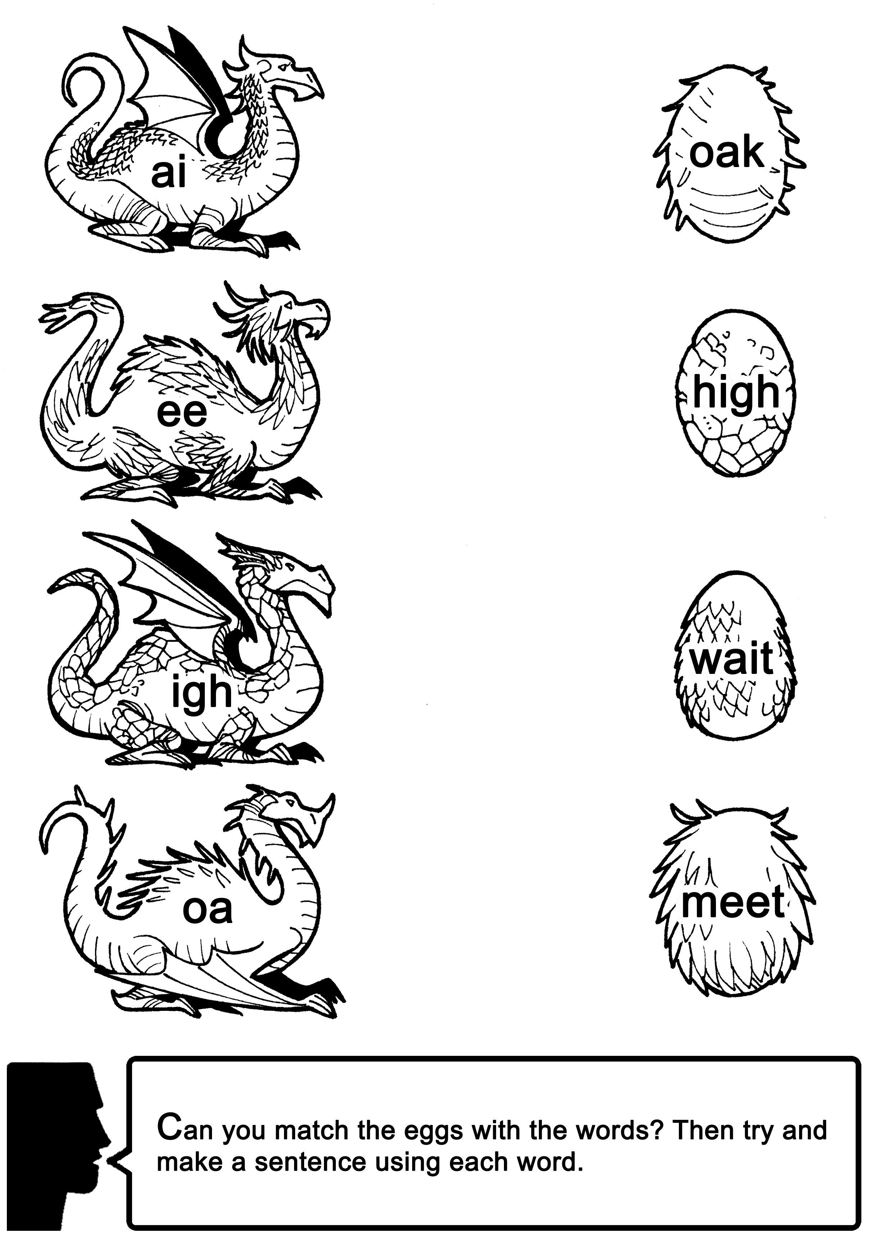
Engagement activities.
Simple to use
Comic content related
GPC of the week focus

Slide 12

Autumn term 2025.
Week 1: Staff training and initial baseline assessments of up to six children per school
Weeks 2 – 7: Intervention activities
Week 8: Final assessment and reporting via ‘What Worked’

Slide 13
Contact for queries and participation:
Catherine Lenahan
Senior Research Officer for Literacy
clenahan@edt.org

