Slide 1
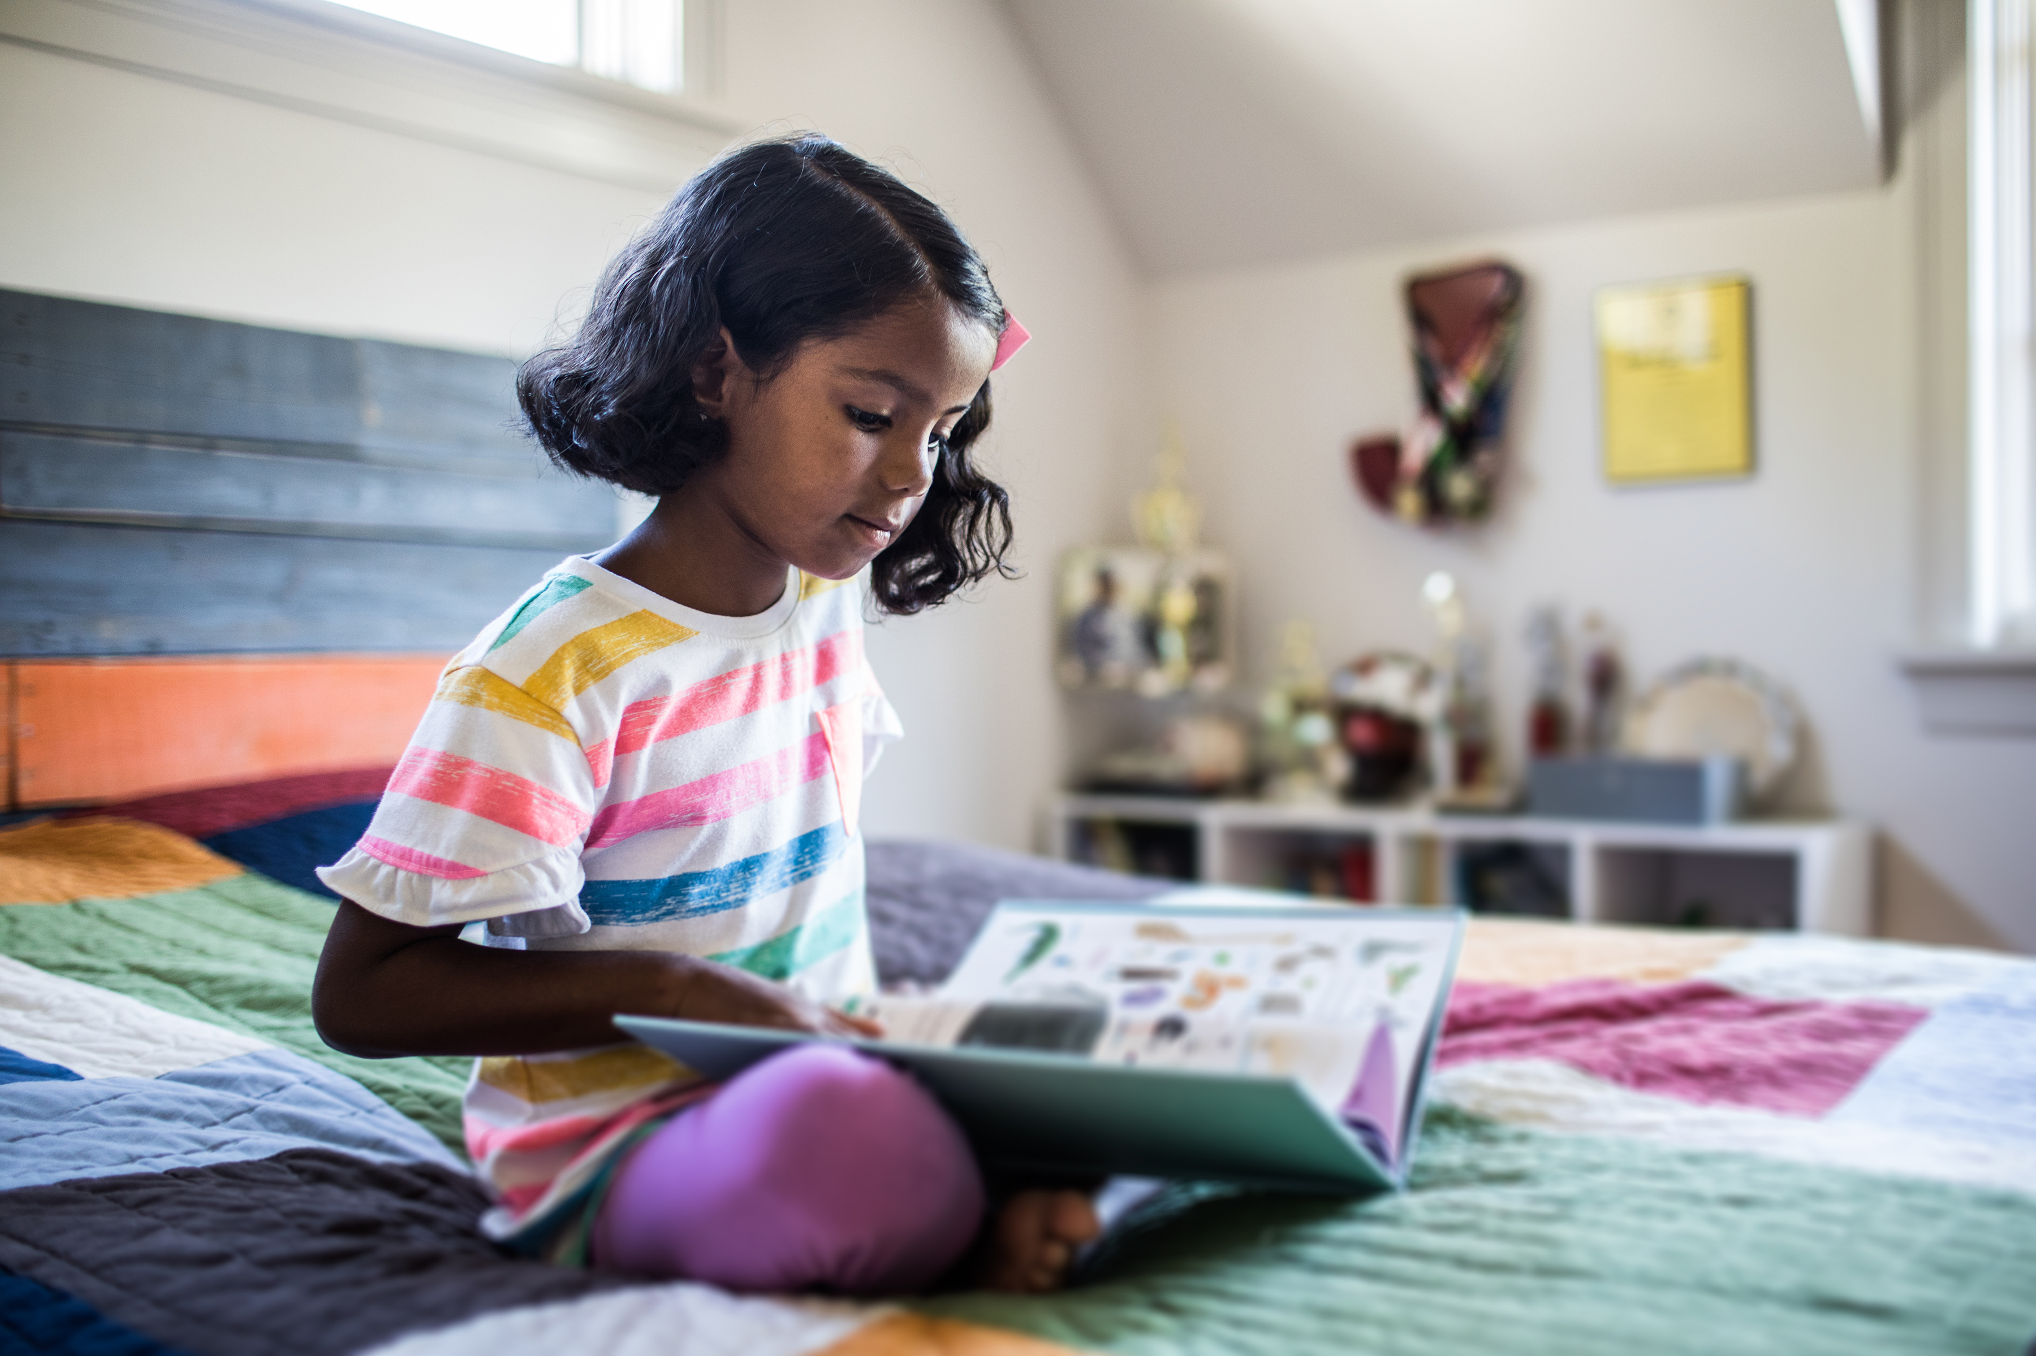

Reading for Pleasure
Space for your school logo
Notes:
Welcome parents/carers. Explain that this short talk is about reading for pleasure.

Slide 2


Reading Instruction
Reading For Pleasure
Learning to read
The skill
Decoding and comprehension
Teacher direction
Teacher ownership
Choosing to read
The will
Engagement and response
Child direction
Child ownership
Notes:
In school, there are two aspects of reading that we focus on: reading instruction (teaching of reading skills) and reading for pleasure.
In our phonics and reading lessons, we focus on teaching the skills of reading- how to break down words and put them together to read (decoding) and how to understand what we’re reading (comprehension). We assess the children’s skills and know what they need to work on next so this reading instruction is teacher directed and teacher owned.
When we encourage children to read for pleasure we are focusing on them choosing to read and them having “the will” or “the want”. It’s less about structured answers to comprehension questions and more about how the child engages with a text. Do they like it? Do they like the characters? Does it remind them of anything? Reading for pleasure is child directed and child owned because they are choosing what, how and when they read.

Slide 3
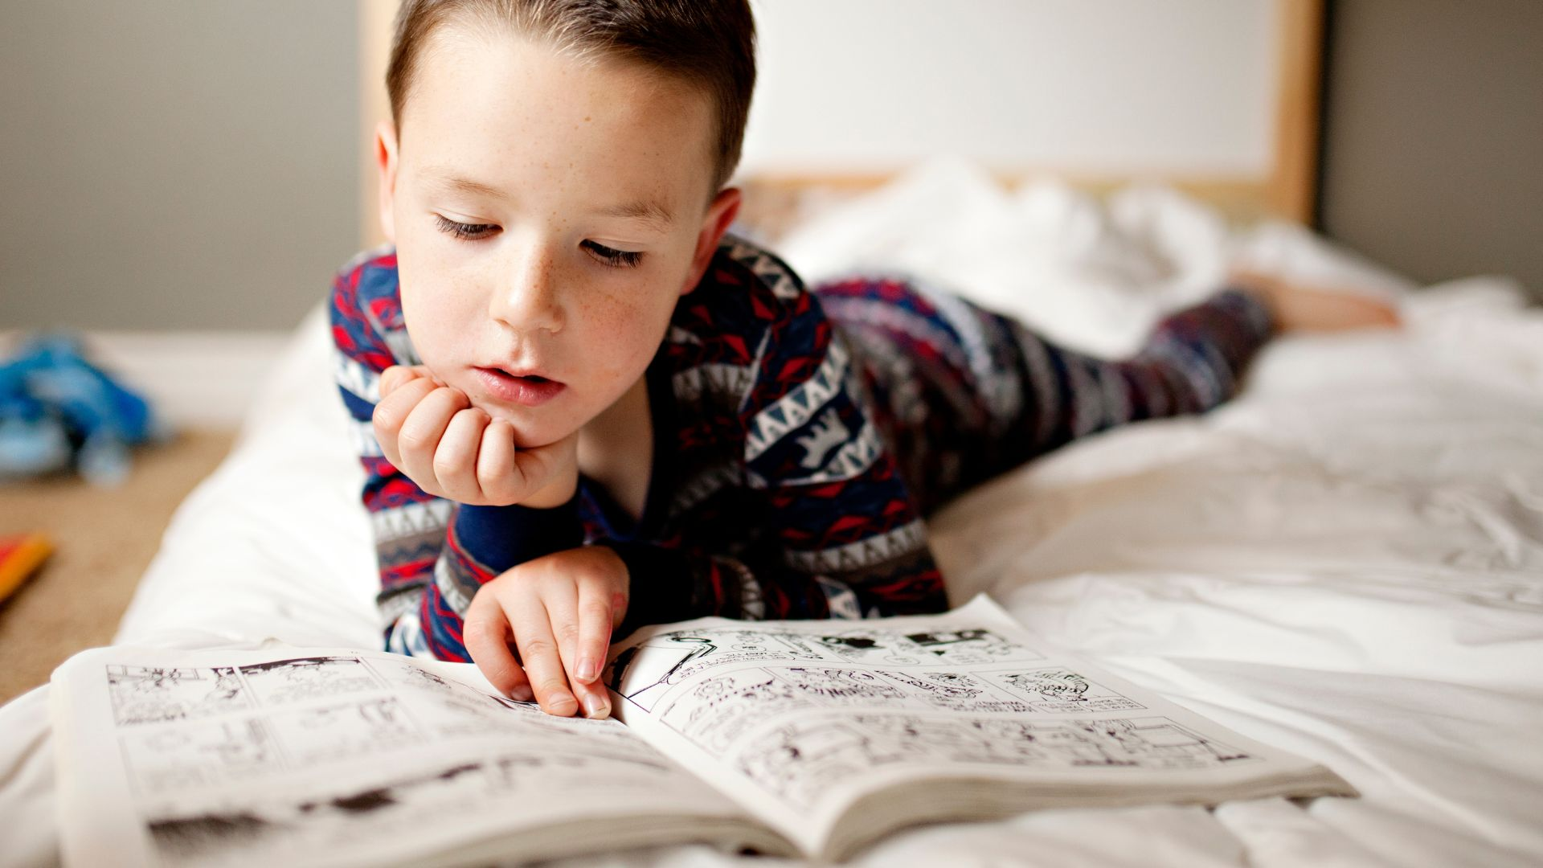
Notes:
Reading for pleasure can look different at different times. It might be a child sitting alone with a book, thoroughly engaged and off in the “book world”…

Slide 4

Notes:
It might be a family dipping into a story or information book together, talking and laughing about what they read and what it reminds them of.

Slide 5

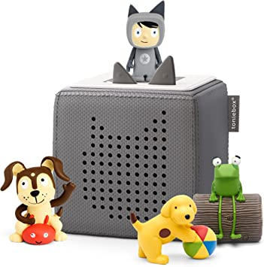

Notes:
It could be choosing to listen to an audiobook.
NLT’s report includes evidence that listening to an audiobook requires the same cognitive skills as reading in print, and also supports the development of skills that children need to read including language comprehension and the ability to understand and retain information.
there is an argument that while listening is physically more passive than reading, it is not actually lazy – actively listening to a narrative requires some level of concentration.
Hearing a story being read can give a learning reader a better understanding of pronunciation and tone, as well as helping them understand the emotional pitch of a story. Author Pam Varley notes, for example, how hearing Harry Potter gives children a better idea of how to pronounce ‘Hermione’.
This may also suggest that the auditory presence of a human voice, whether recorded or live, as in read by a teacher or parent, could stimulate a stronger response than the written narrative. Waite interrogates this, referring to the ‘emotional cortex’ of the brain as the part that responds to human voices telling a story, and that where adolescents are more and more at risk of isolation, it is important to keep in touch with this.
Introduction of new vocabulary and development of word-recognition skills – exposure can increase word-recognition ability
• As noted earlier by Miller (2010), access to higher level texts can improve comprehension and give struggling readers access to content more appropriate for their age and interests
• As has often been acknowledged with ebooks (for example, Kozlowski, 2012), audiobooks can be a private experience, with the title unknown to others, meaning that if a child does want to ‘read’ a lower-ability or -aged book they can do so without scrutiny from their peers
• Novelty – listening on a device might be considered more ‘fun’ than reading a paper book, particularly when a production features a dramatic reading or famous voice

Slide 6

Notes:
But what is key to reading for pleasure is the idea of choice. Choosing how, when and where to read.

Slide 7
boosts motivation to learn
escapism
reduces stress
Why Should Children Read for Pleasure?
increases vocabulary
helps learn about the lives of others
boosts communication skills
boosts creativity
Notes:
Some facts you may want to share with this slide:
Research has shown that reading for as little as 6 minutes can reduce stress by up to 60%.
The language we find in books is more extensive and challenging than the language we tend to use as part of our day to day speech so reading helps to increase vocabulary.
Reading about the lives of others can help us to boost empathy.

Slide 8

This Photo by Unknown Author is licensed under CC BY-SA-NC
Notes:
But ultimately the main benefit is that it’s fun and an enjoyable way to spend time.

Slide 9

Talk About Books
Notes:
Have conversations about books. What books do they enjoy? Why? What books did you like as a child? What characters do you like? Is there anything in “this book” that you’d change?

Slide 10
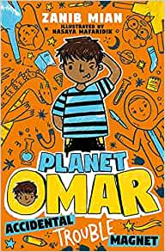
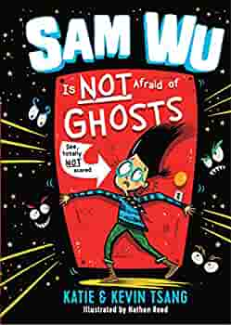
Make Books Visible
Notes:
When you get books from school or the library, have them on display if possible. Children won’t seek them out if they’re hidden away. Make them something easily accessible.

Slide 11

Get Comfy and Read Aloud
Notes:
Make it fun and comfortable. You could snuggle on the couch under blankets, get comfy in bed, make a reading den or a fort.

Slide 12


Visit the Library
Notes:
You might want to change the picture of Toxteth Library to the library closest to your school.

Slide 13
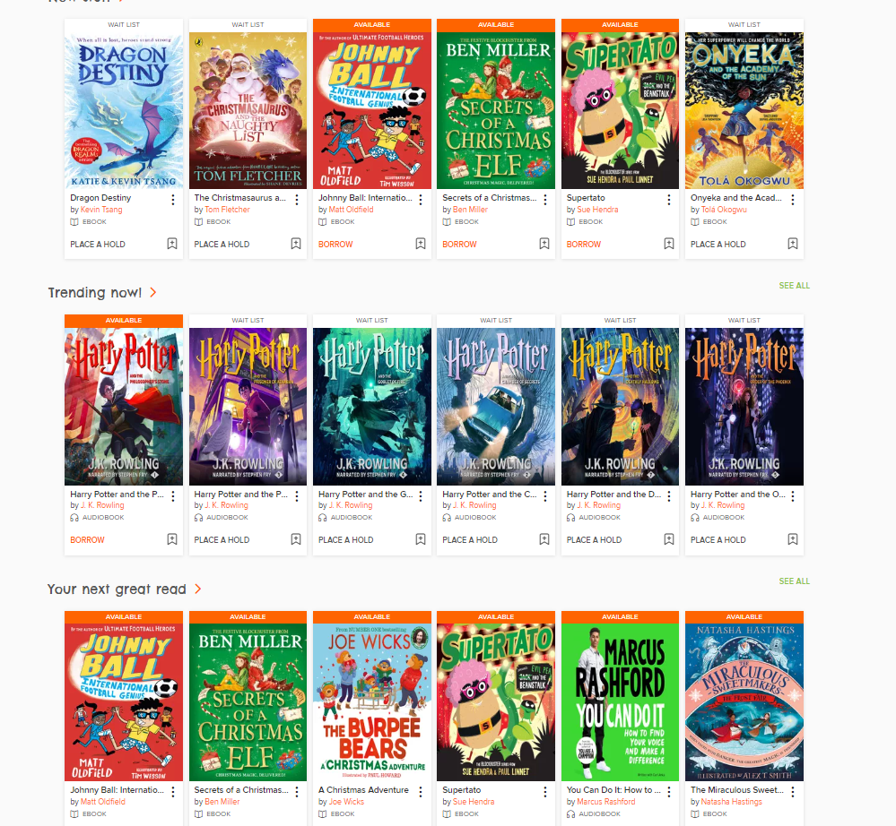
Notes:
Liverpool Library has an online catalogue that you can access at readliverpool.co.uk featuring ebooks and audiobooks

Slide 14

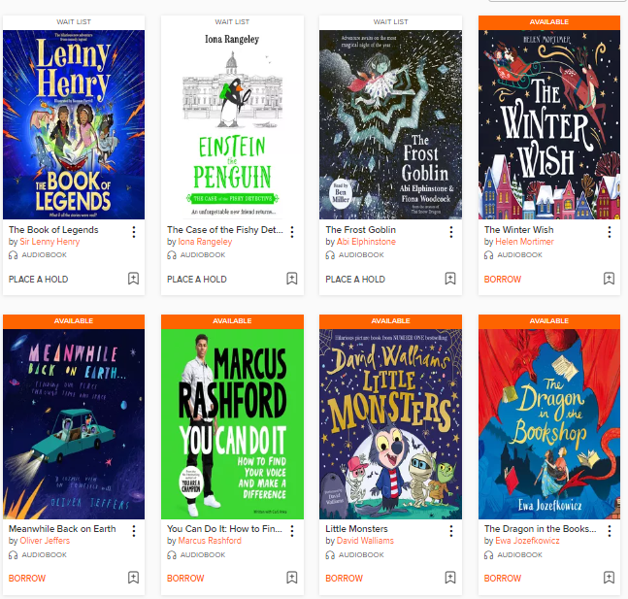
Listen To Stories Together
Notes:
Listening to stories together in the house can be fun. It’s also a good way to pass car journeys.

Slide 15



Read For You
Notes:
Research shows that children who see the adults around them reading are more likely to read themselves. It doesn’t need to mean reading a thick story from beginning to end. It could be a newspaper, magazine, cookbook… anything!!

Slide 16
Have Fun Together
Notes:
But ultimately… have fun. If we make reading a chore, children are less likely to want to do it. Try not to stress about it and have fun with it! Children will be more likely to want to join in and keep reading!

